Slide 1
The Modern Software Developer
CS146S
Stanford University, Fall 2026
Mihail Eric
themodernsoftware.dev

Slide 2
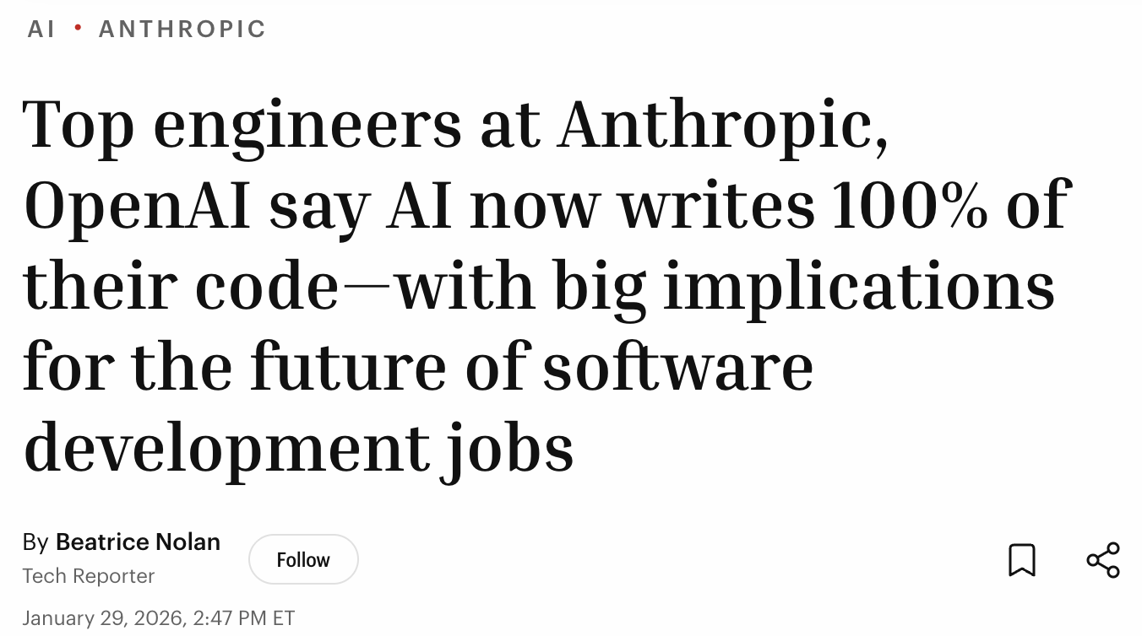
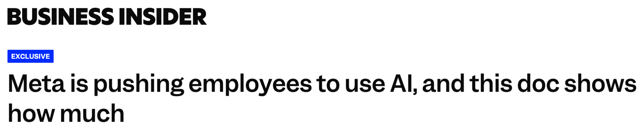

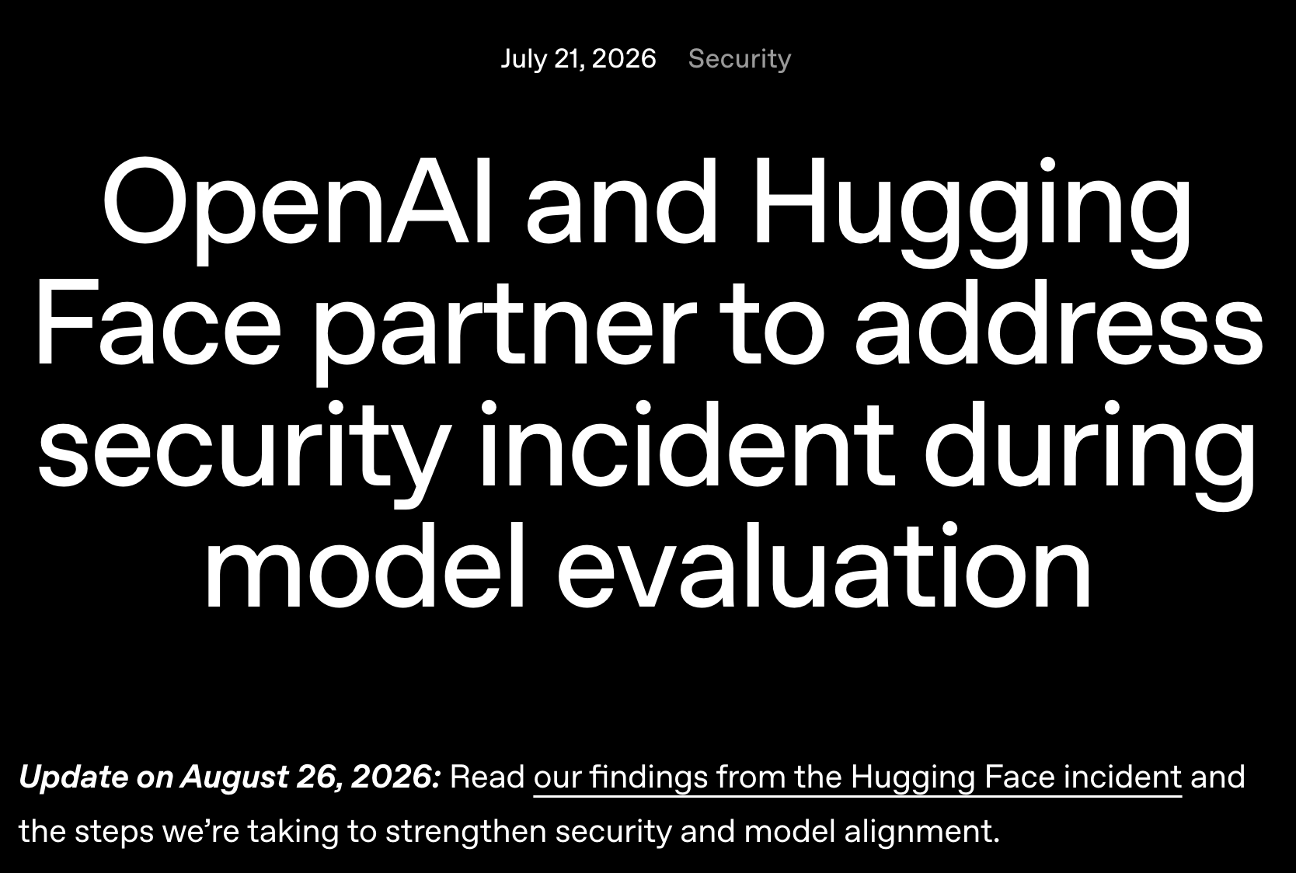
State of the World: 2026
themodernsoftware.dev
Notes:
With release of Claude Opus 4.5 in early December of 2025, the power of coding agents skyrocketed
They predicted it in 2025 and they have pretty much closed the gap
Coding assistant → true agentic work
Using AI in the workforce is a non-negotiable
Agents are getting too good which introduces new challenges
Hacky sack as a trend is back

Slide 3
What That Means For You
Broader industry-wide AI adoption means companies need you
  Becoming “AI-native” is now the new goal
But…the floor is higher
Software developers are more productive than they have ever been in history and so expectations have grown
Focus on holistic systems-level thinking, architectures, and abstractions
  When combined with AI-first development practices you will be irreplaceable
themodernsoftware.dev
Notes:
While trend last year was removing of entry level roles because “AI will replace those roles”, now teams want to upskill and transform themselves to be more AI-native
You guys were forged in this generation. Many of you started your CS journeys when ChatGPT just came out
Many employers have adopted blanket policies like no hiring of L3/L4s. Or at the very least you must be L5 and above quality
Students learning CS today can be an order of magnitude better than I was when I was learning. With AI coding an engineer can pick up tech stacks and tools at an unprecedented pace. What a time to be alive!
If you think in terms of systems, understand business context, think through resilient architectures and abstractions, AI will strap a rocket to your back in terms of productivity

Slide 4
The Modern Software Developer
themodernsoftware.dev
Notes:
Which brings us to this course…

Slide 5
This class is about principles not tools
themodernsoftware.dev
Notes:
This is a class for fairly experienced engineers to truly become 10x engineers

Slide 6
10 weeks in 1 slide
themodernsoftware.dev

Slide 7
The Takeaway
Human-agent engineering
  Focus on the skills that are not yet replaced by AI systems
  Business and product understanding
  Become the tech architect – develop good taste for software systems
  Communication is crucial
LLMs are only as good as you are
  Good context leads to good code
  If you can’t understand your codebase, neither will an LLM
  Prevent AI slop
Experiment aggressively
themodernsoftware.dev

Slide 8









Course Logistics
Instructor (Hi!)
  Stanford undergrad/grad
  Head of AI at Monaco, an SF-based startup in the sales space
  AI Advisor for dozens of companies from seed-stage startups to public enterprises
  Built first LLMs at Amazon Alexa
  Founded and sold an ML education startup
  Founded a YC-backed AI coding company
2 awesome CAs
  Isaac Kan
  Vijay Daita
themodernsoftware.dev

Slide 9
Course Logistics
https://themodernsoftware.dev
Lectures
  Tue/Thur 5:30-6:20 pm
Deliverables
  6 assignments (1x/week) focusing on lecture material practice
    https://github.com/mihail911/modern-software-dev-assignments
  3-4 contributions to OSS repositories
  1 final open-ended project in which you will exercise AI coding principles we cover
Grading
  50/15/30/5 breakdown for project/assignments/OSS/participation
themodernsoftware.dev
Notes:
All lecture materials on official course page
Additional reading will be there
Links to assignments
This class is going to be hard

Slide 10
Course Logistics
OSS Partners
  15 of the top AI-native open-source projects including Vercel, Warp, Marimo, Milvus, Pi, CrewAI, Browserbase, HeyGen, CopilotKit, Semgrep, OpenHands, Cmux, Arize, Sloth, Anyscale
Guest Lectures
  Founders and engineering execs leading top AI developer teams today (creators of Claude Code, Devin, Replit, Factory, and more)
  Billions of dollars raised, tens of billions in valuation
  Don’t miss these talks!
themodernsoftware.dev
Notes:
The OSS partner assignments are designed to give you hands on experience working in and contributing to complex codebases

Slide 11
How to Build Claude Code in 200 Lines of Code
themodernsoftware.dev
Notes:
In order to understand how to best develop with coding agents, we need to understand how agents are built. That will be the focus this week.

Slide 12






It’s that simple
themodernsoftware.dev
Notes:
User interacts with coding agent client (windsurf, cursor, claude code) and runs a loop with an underlying llm. Sometimes the llm issues tool calls which the client executes (off-LLM)

Slide 13
Steps
Read in terminal and keep appending to conversation
Tell LLM what tools are available
  It asks for tool use at appropriate time
  You execute tool offline and return response
  Tools
    “Read_file”
    “List_dir”
    “Edit_file”
themodernsoftware.dev

Slide 14

Let’s build a coding agent from scratch!
themodernsoftware.dev

Slide 15
Questions?
themodernsoftware.dev

